Slide 1

Movement detection PCB using 24GHz radar sensor
Presented by :
Puniyam.Rajendran.Priyadarshini – 1112329
Sri Chaitanya Durga Prasad.Mojjada-1112322
Mateo Ceballos Querol - 1112948

Slide 2
Aims
Hardware used
24GHz CW – Radar sensor
Operational Amplifier LM358N
FreeSoc 2 (PScC5LP)
Software used
Matlab
Kicad/PCBView
PSoc creator
Build up a system concept
Break down the requirements
Circuit, PCB and Software development

Slide 3
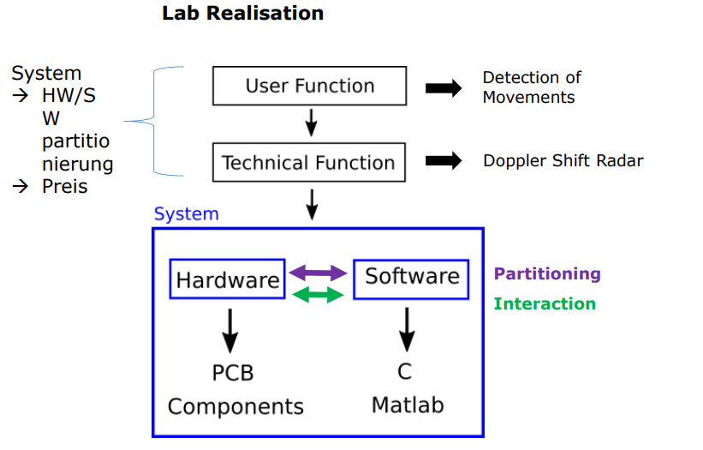
Project design flow

Slide 4
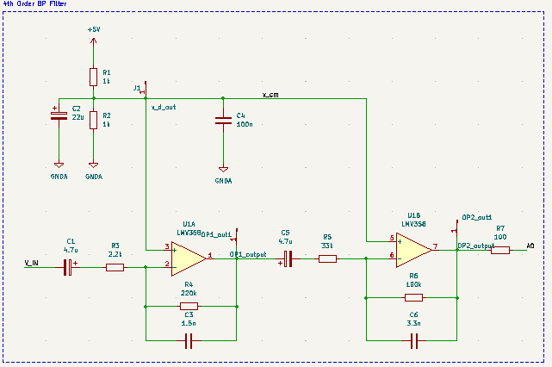
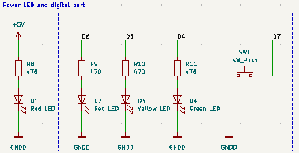
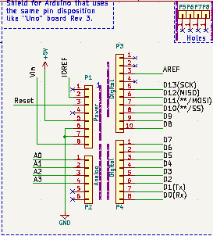
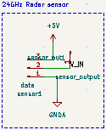
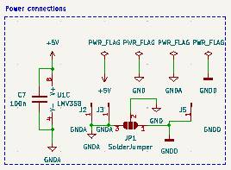
Circuit Design

Slide 5
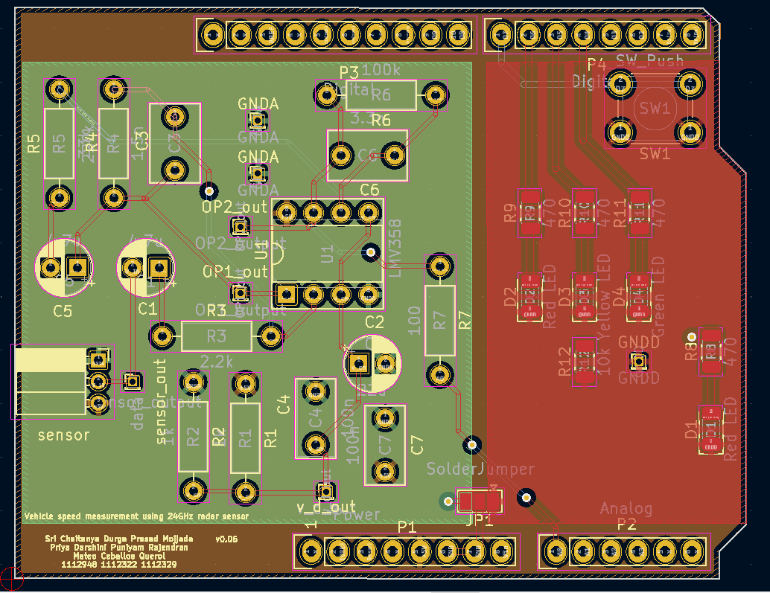
PCB Layout

Slide 6
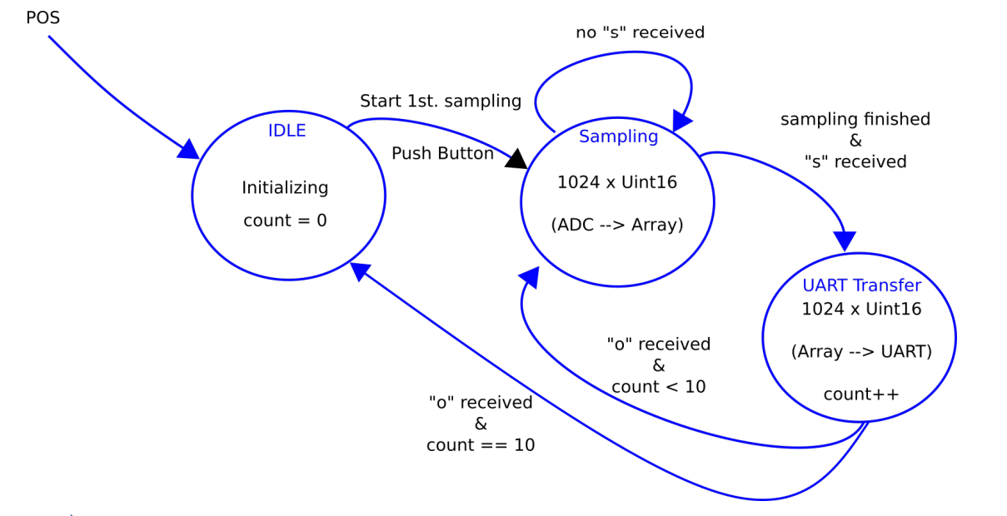
Software development: state machine

Slide 7
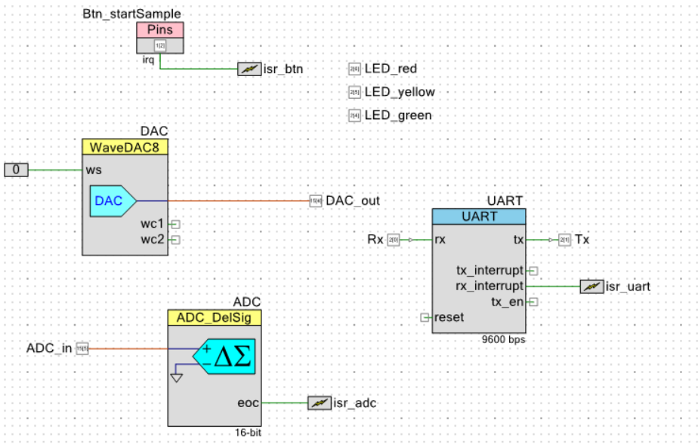
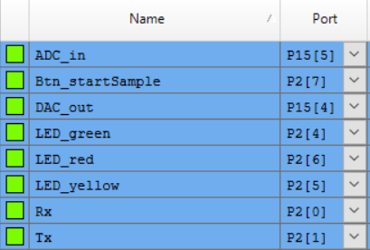
Software development: Top design & Pins

Slide 8
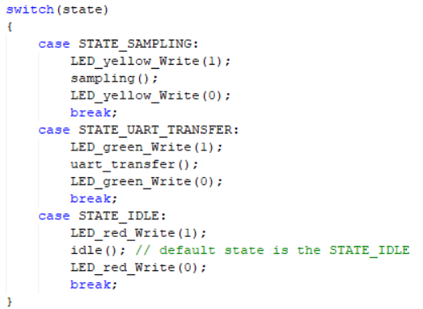
Software development: state machine

Slide 9
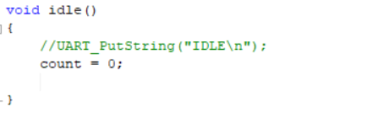
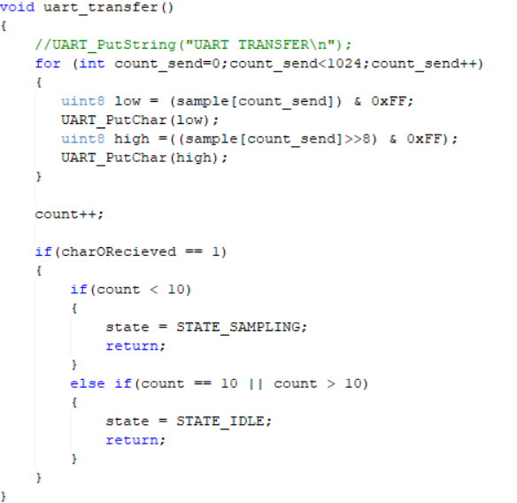
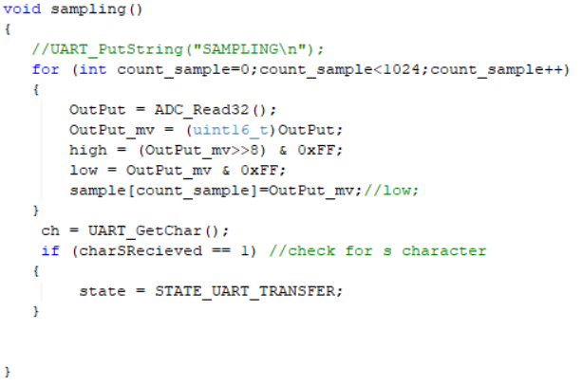
Software development: States

Slide 10
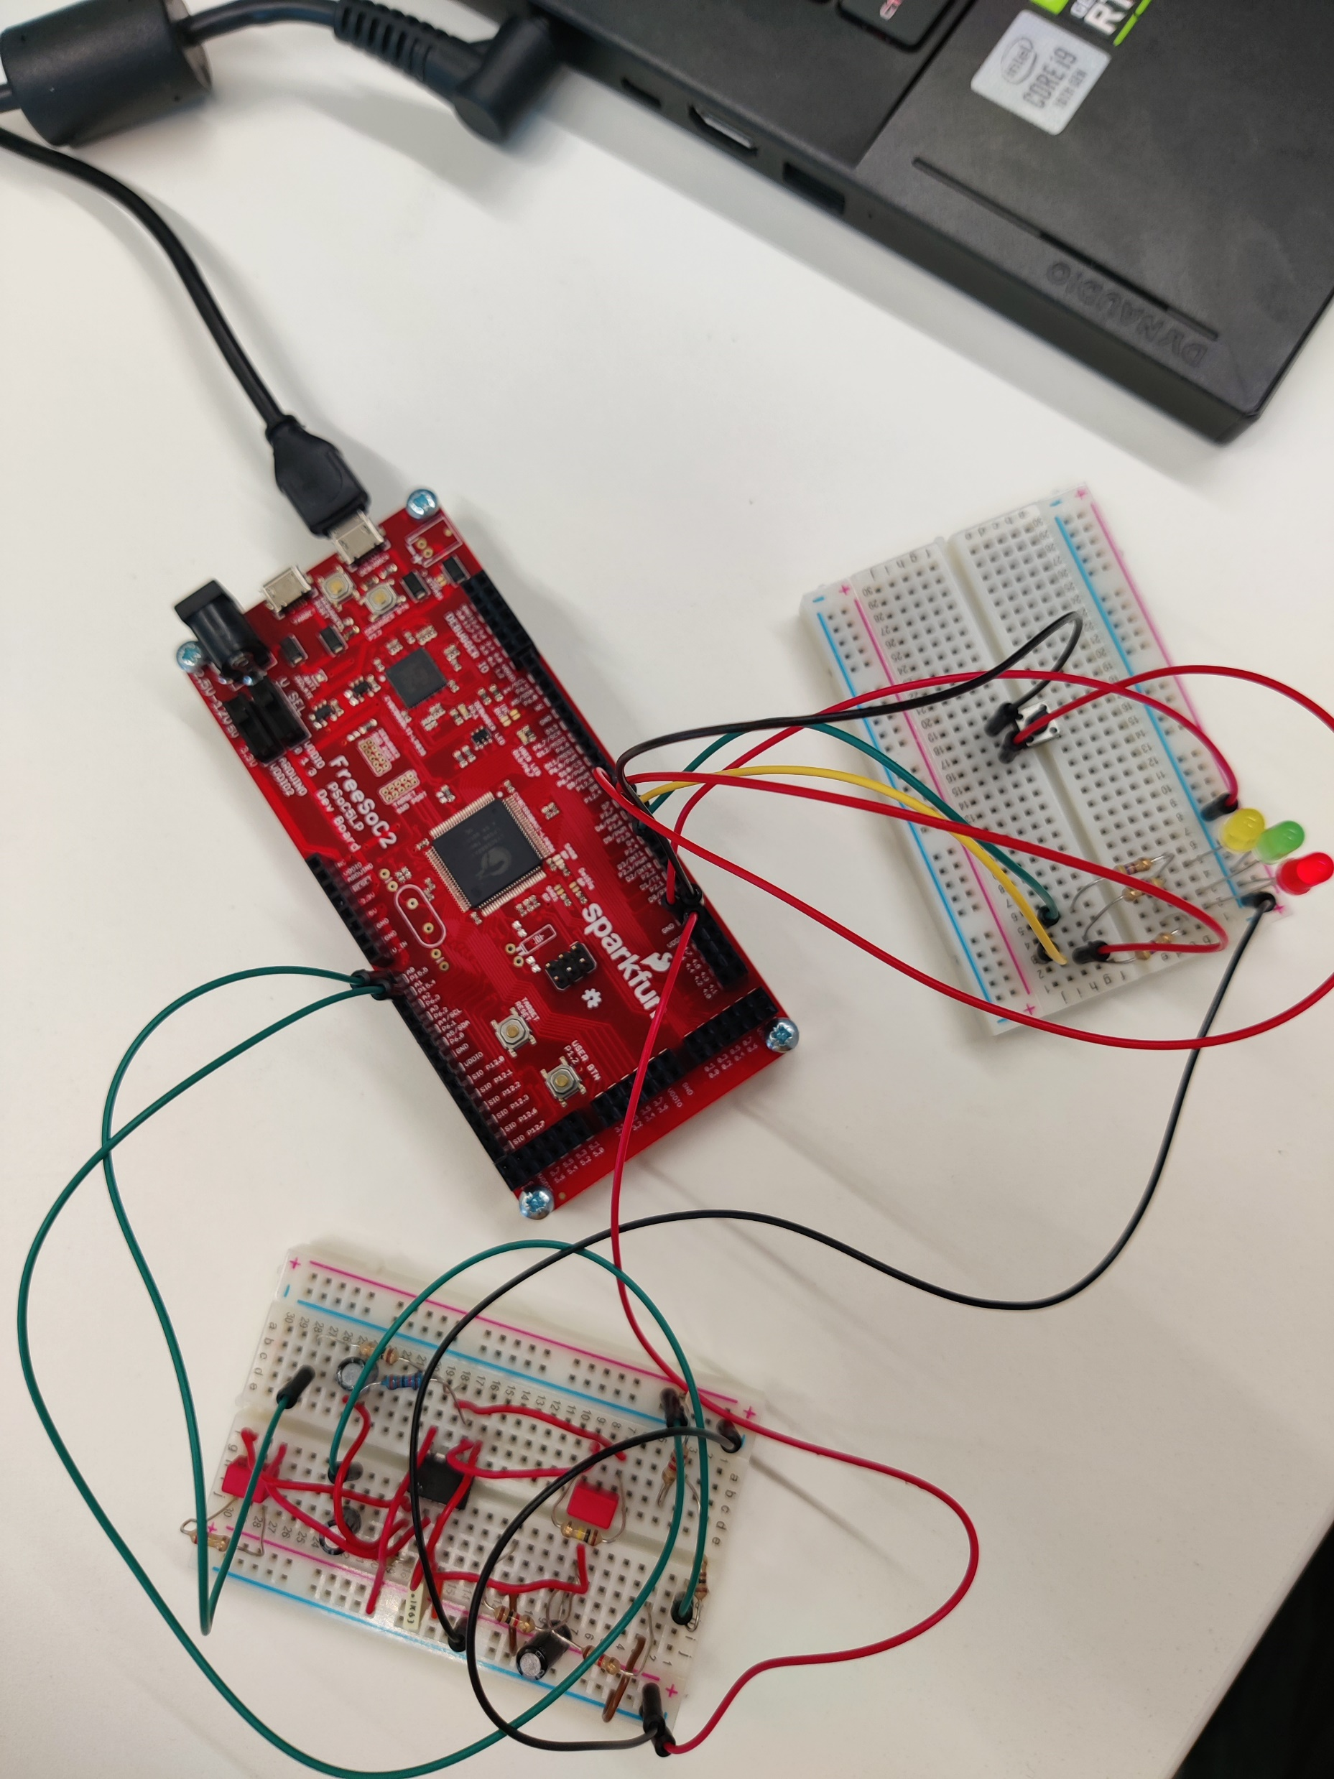
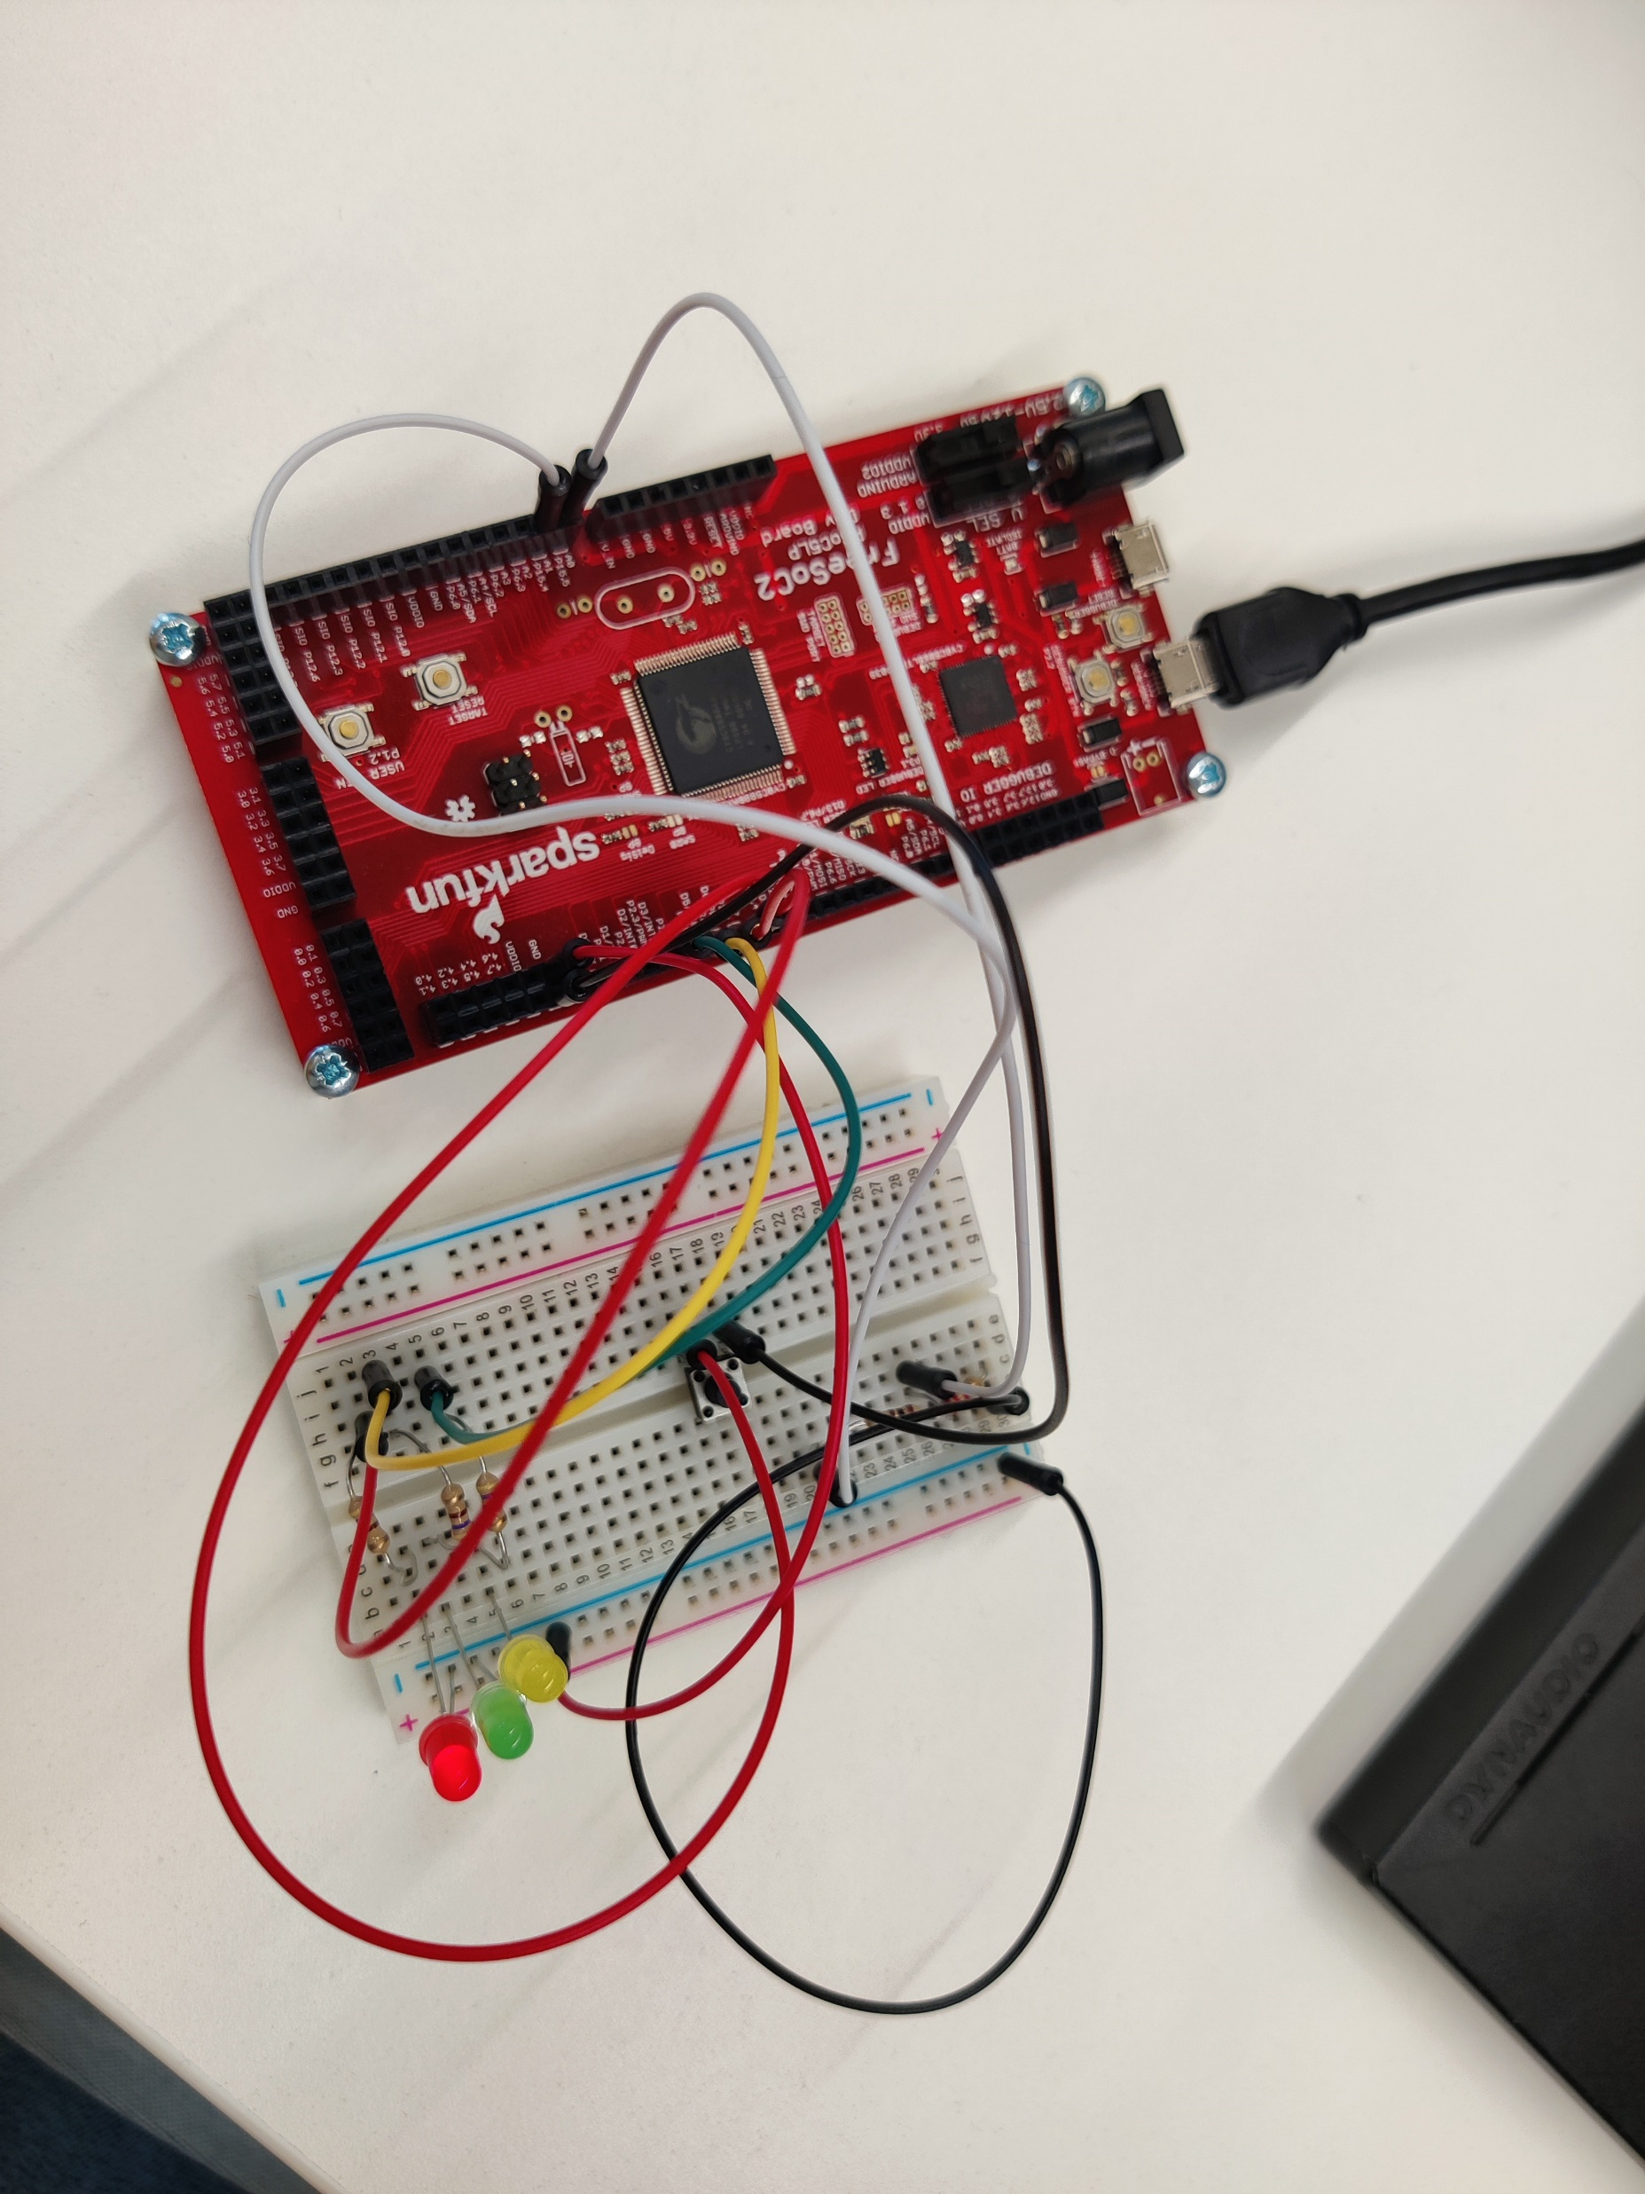
Breadboard tests

Slide 11
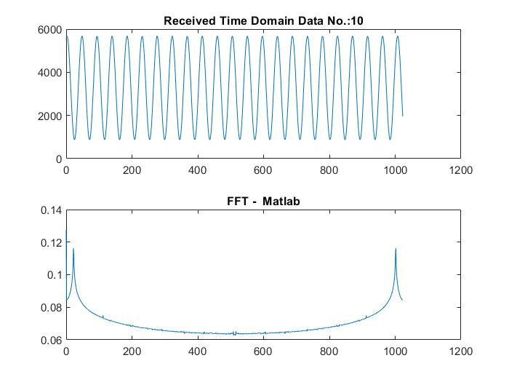
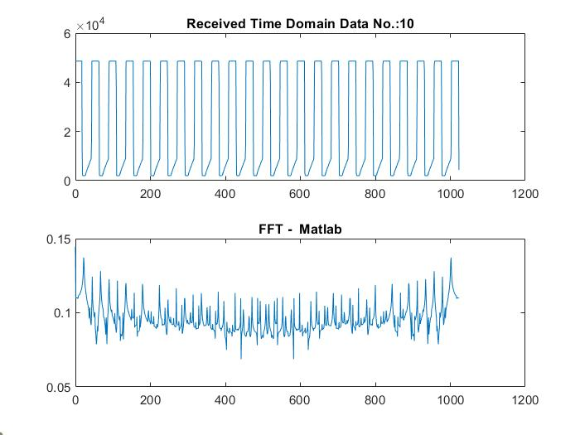
MATLAB results
Voltage divider output after 10 transfers
4th order BP filter output after 10 transfers

Slide 12
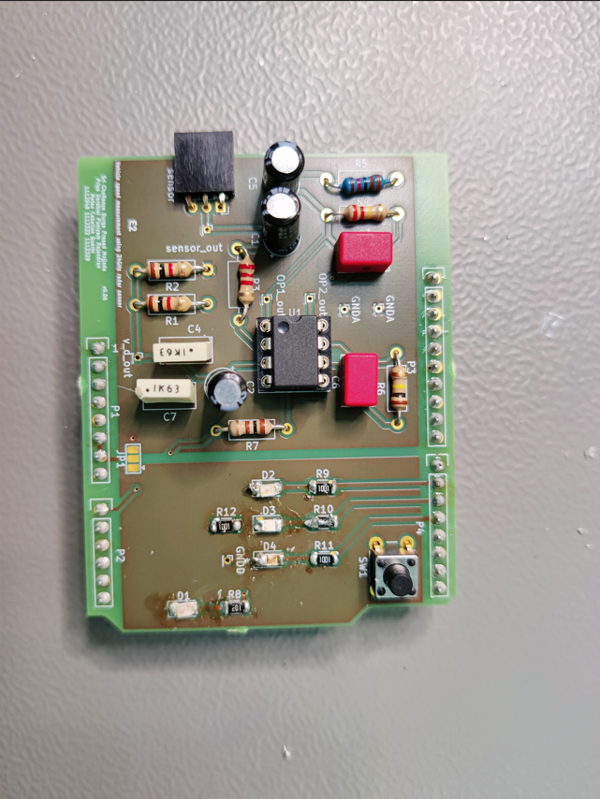
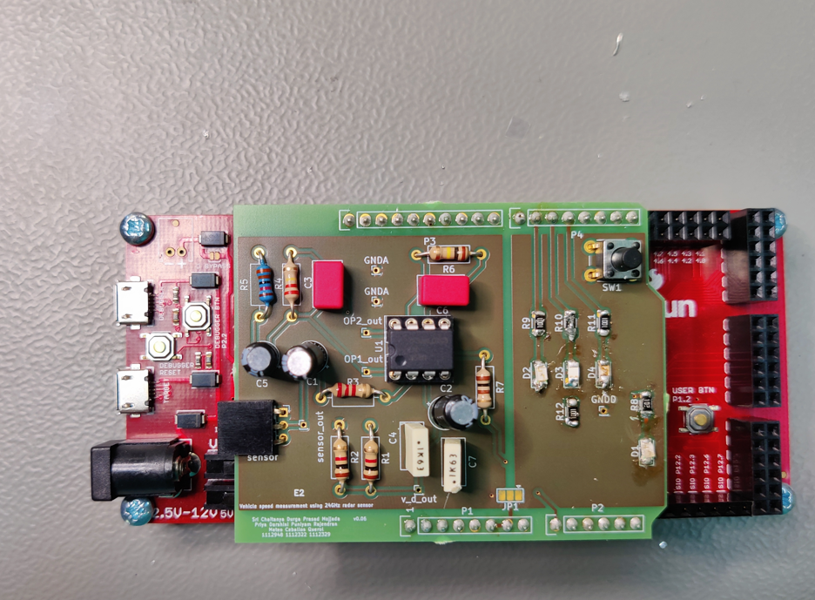
Final PCB

Slide 13
Further improvements
Use perfboard/Veroboard instead of breadboard to reduce noise while testing
1
Use 3 LEDs as distance measurement (like a traffic light system)
2
Use advanced CFAR algorithm to get accurate results
3

Slide 14

THANK YOU FOR YOUR TIME
ANY QUESTIONS?

